Slide 3
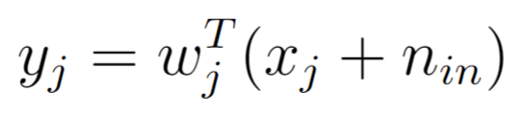
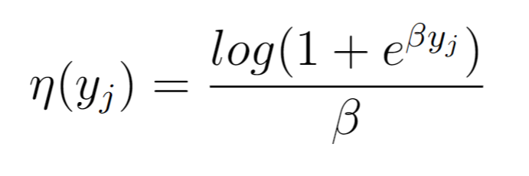
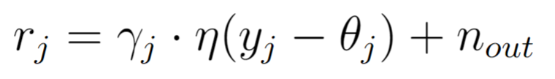
Forward model in 3 easy steps
1- Linear weighted inputs
2- Softplus output nonlinearity
3- Gain and threshold

Slide 4
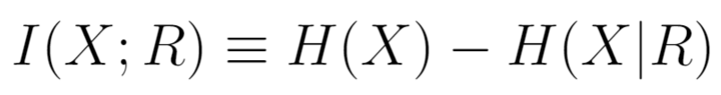
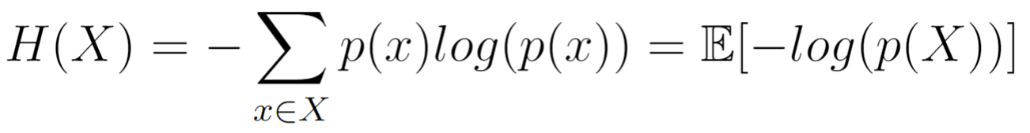
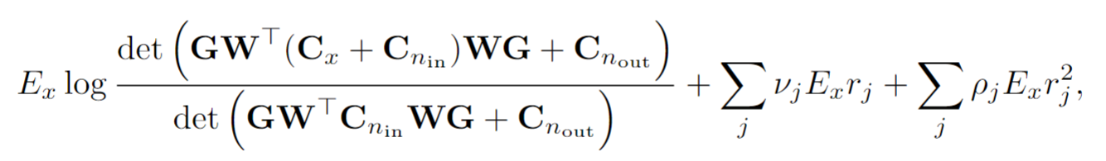
Maximizing mutual information

Slide 5
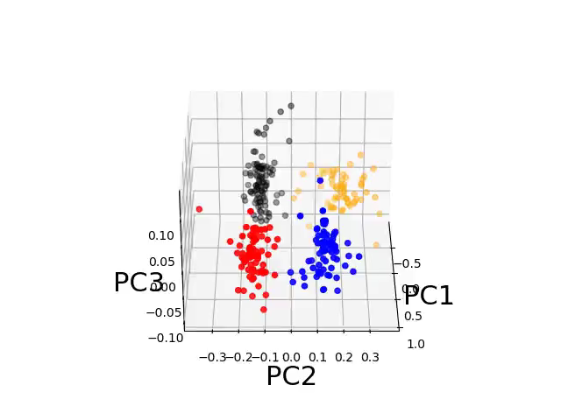

Slide 6
Difference-of-Gaussian restriction on RFs

Slide 7
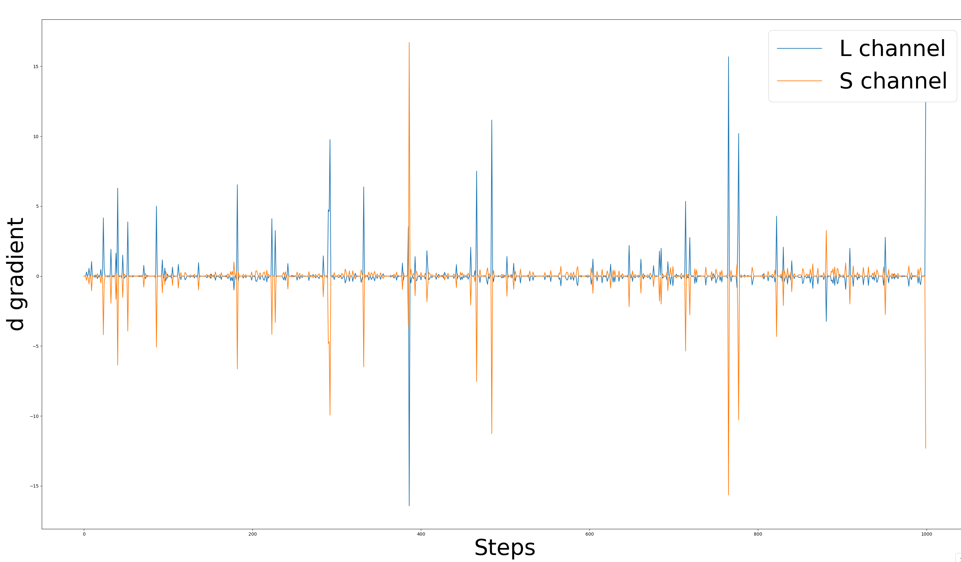
Gradients for the d parameter in L and S channels are always opposite in sign for a single neuron (this is true for all the neurons I’ve tested)

Slide 8
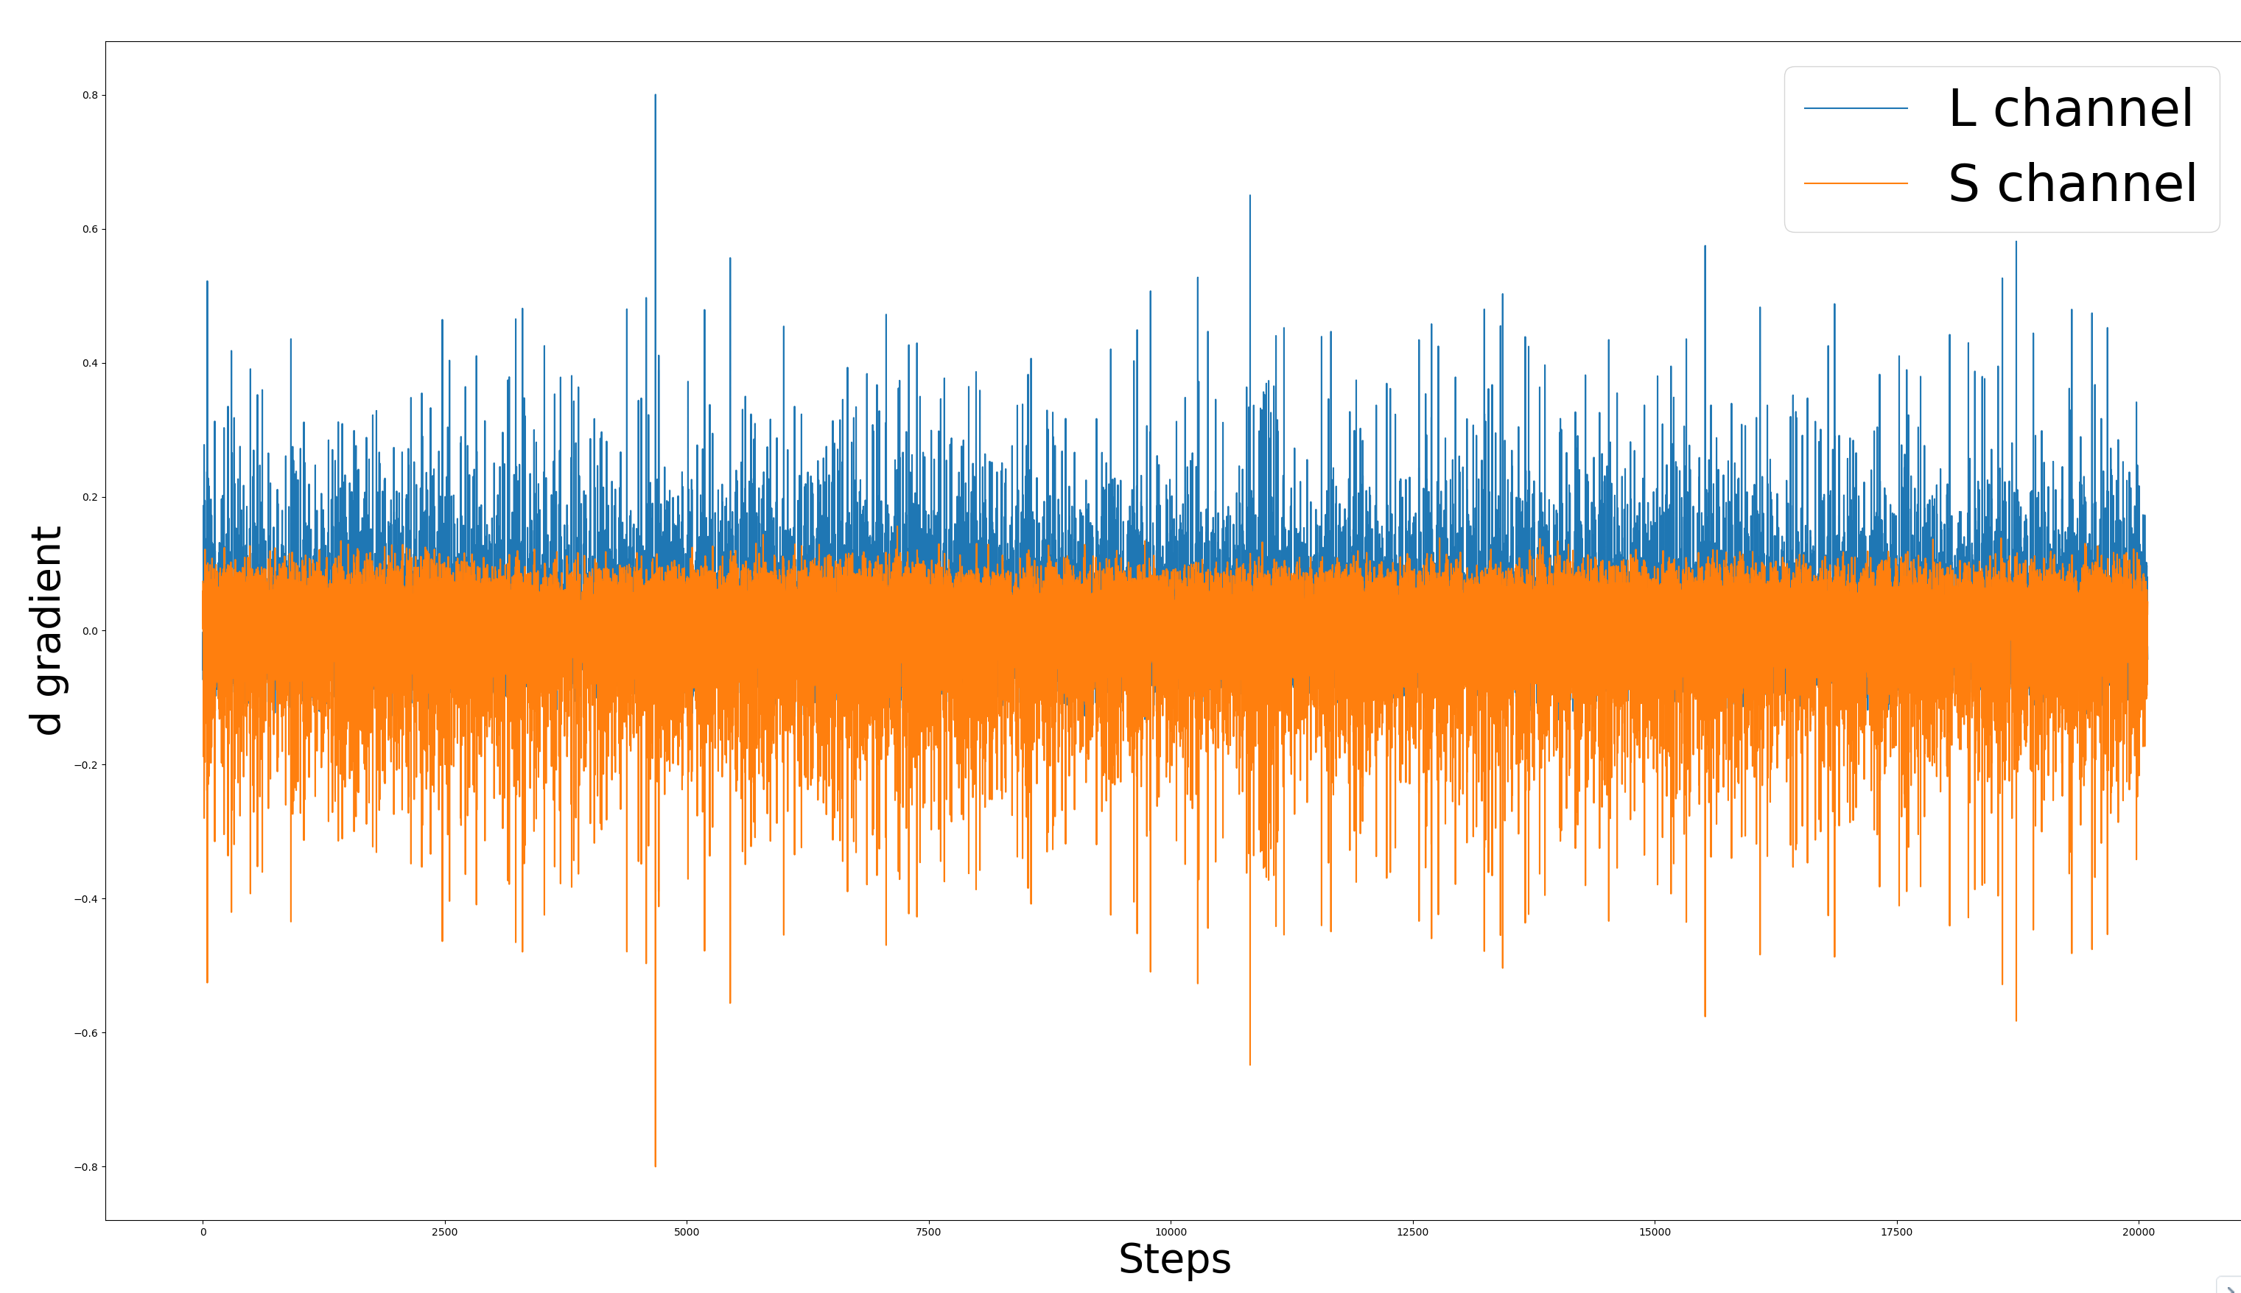
Positive and negative gradients for each channel do not cancel out (this is not true for all neurons)

Slide 9
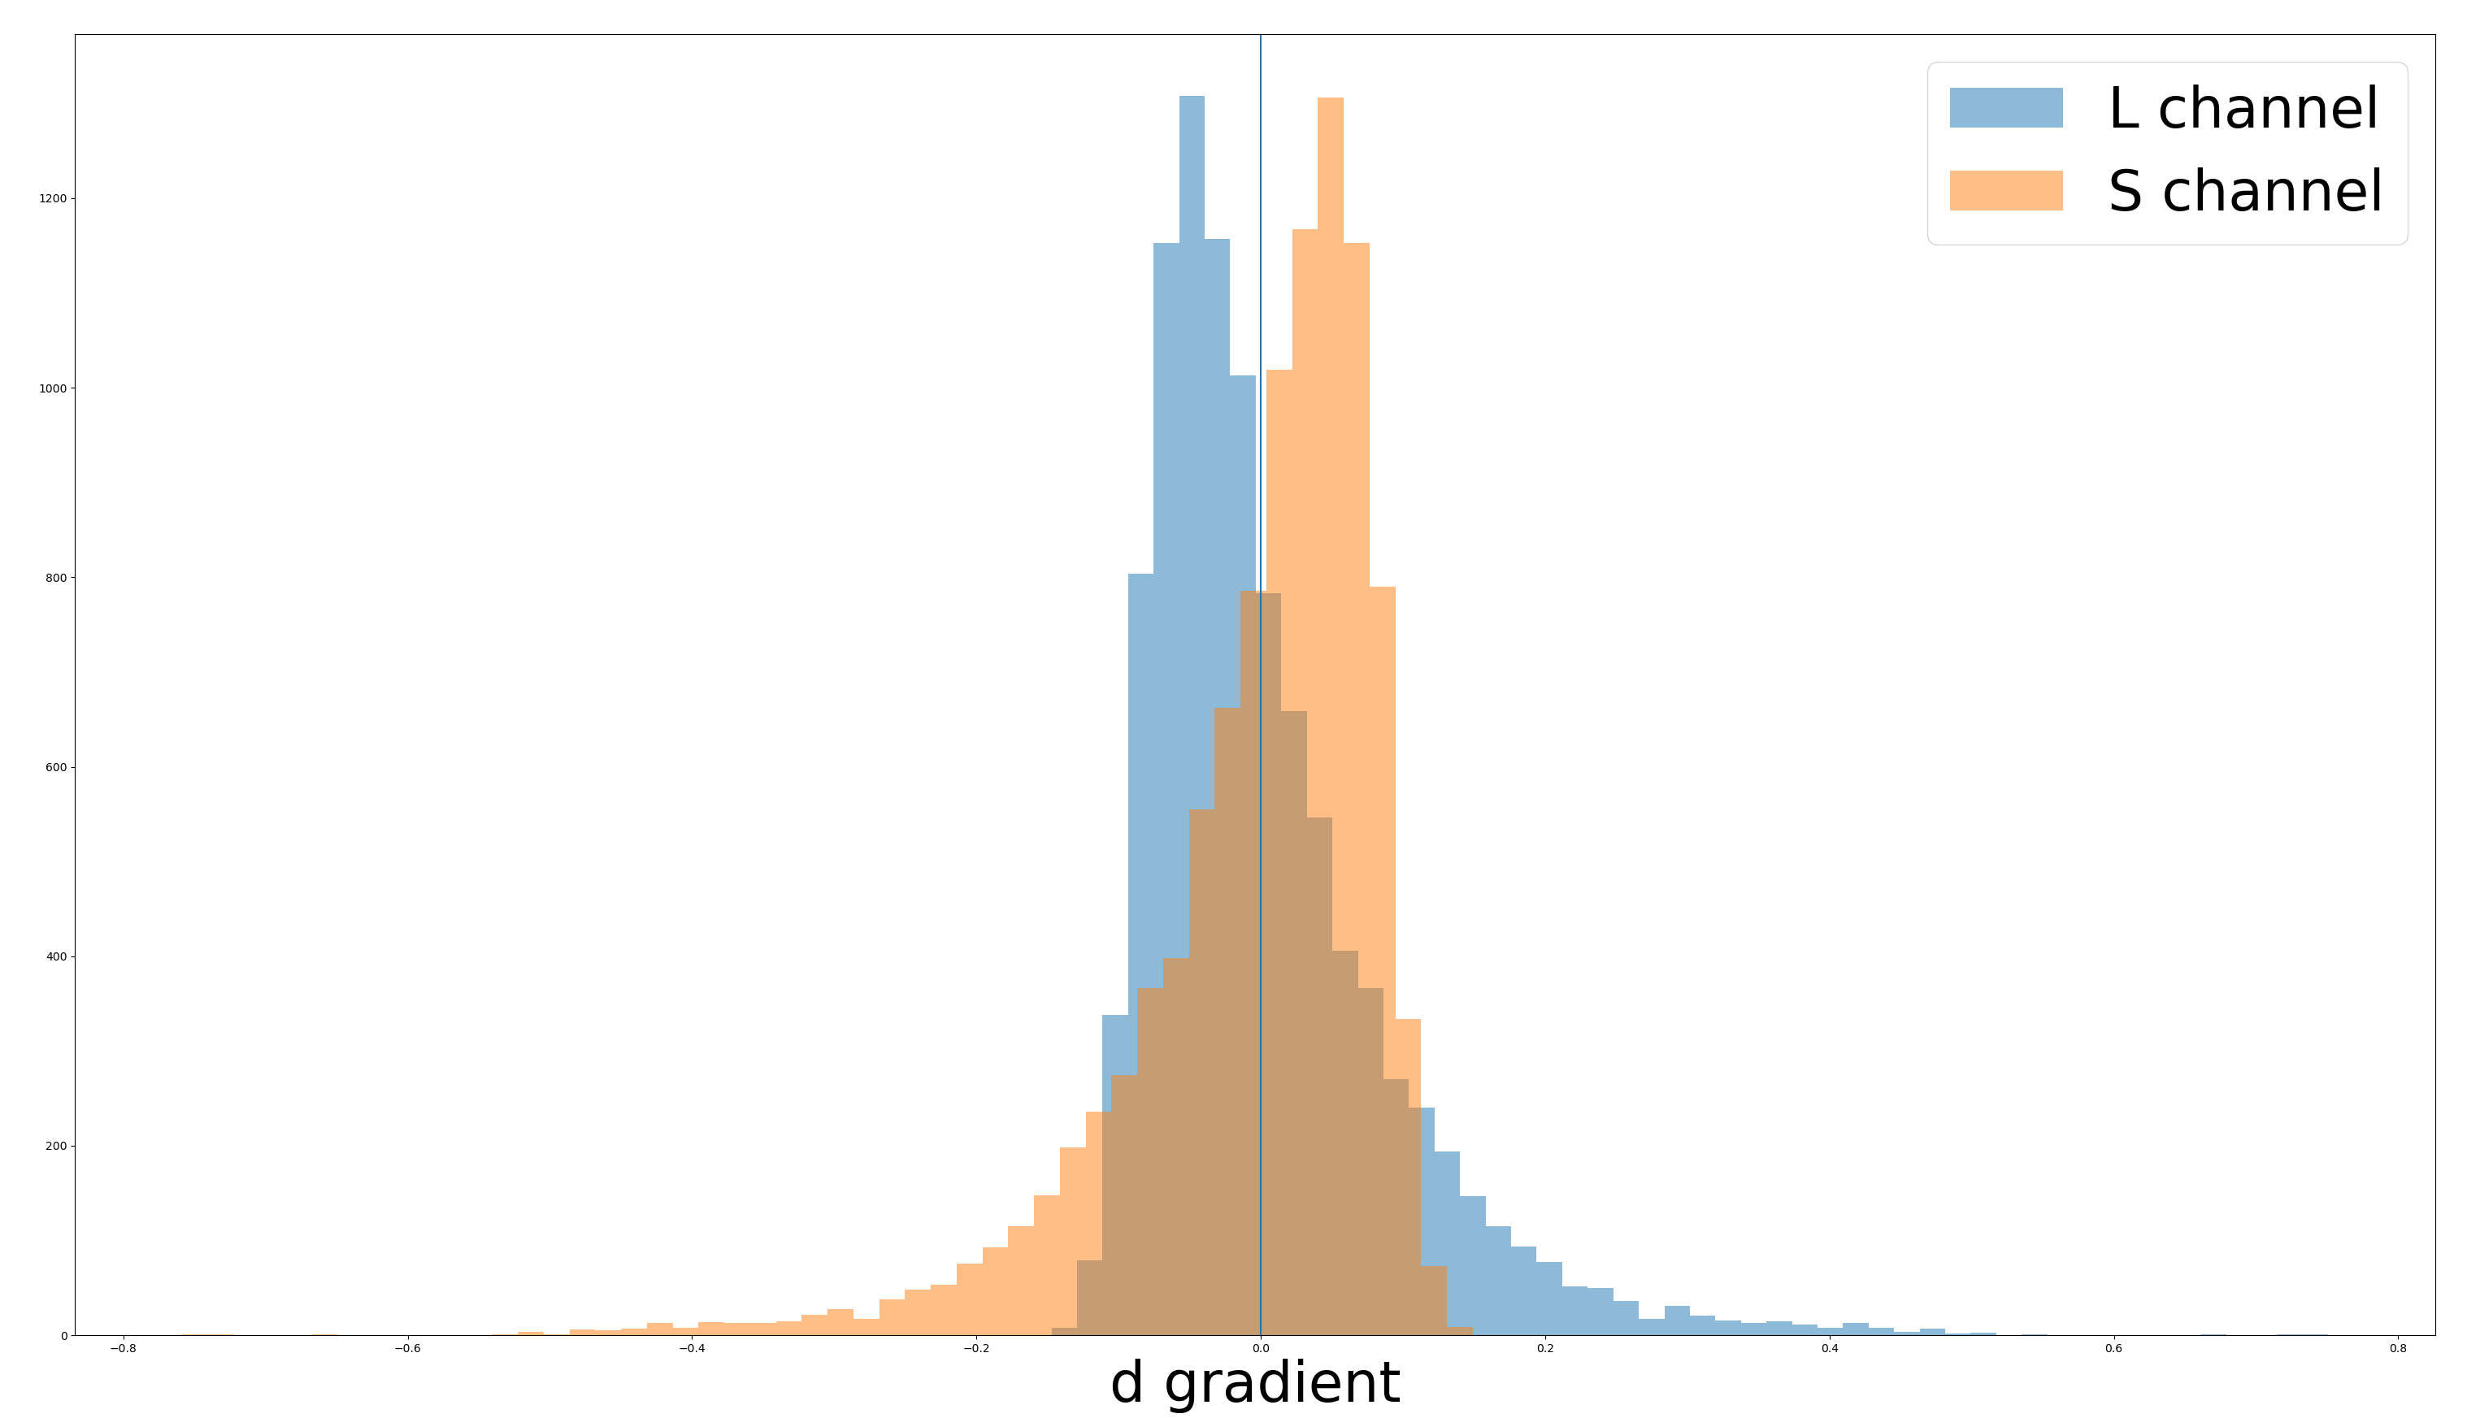
Ps: The mean of each distribution is half a standard deviation away from 0

Slide 10
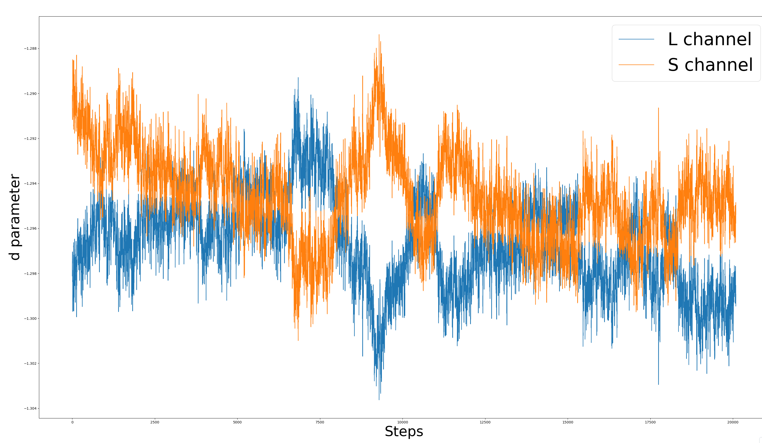
d parameter does not change much across steps

Slide 11


Why does that happen?
Gain parameter:
Sigmoid function on d:
Difference-of-Gaussian restriction on RFs:
Normalization on weights:

Slide 12
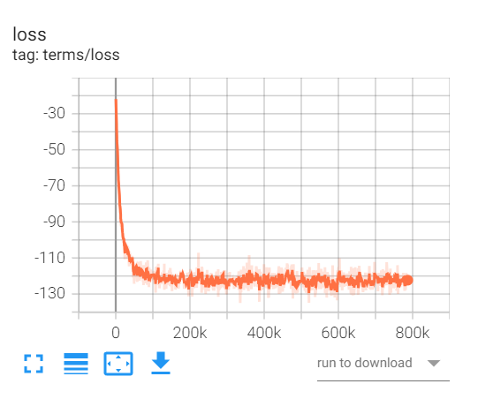
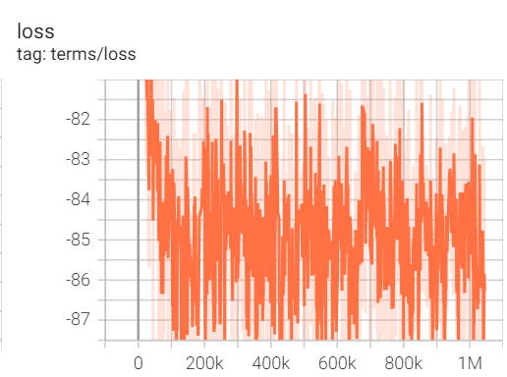
Remove gain and sigmoid on d

